Slide 1

EDA of Unicorn Companies
By Yejide Ayeni

Slide 2
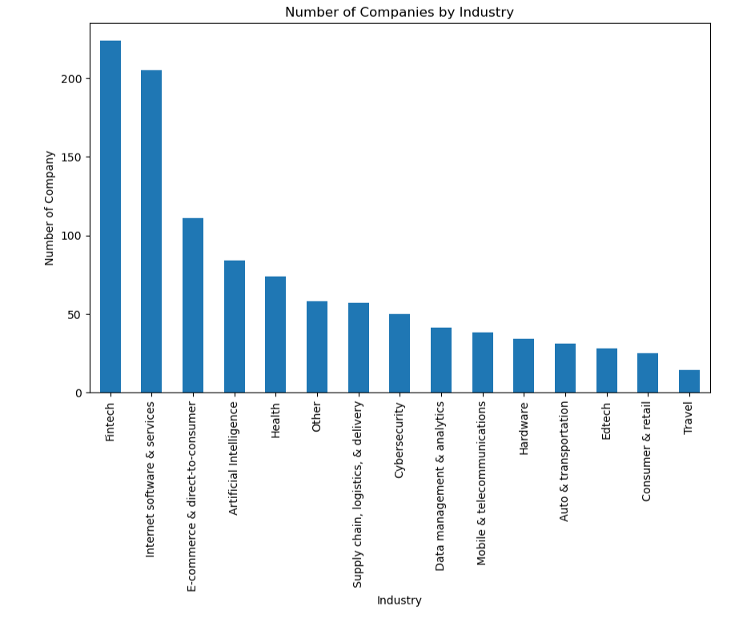
High Growth Industries
Certain industries like Artificial Intelligence, E-commerce & direct-to-consumer had been seen to harbour a high valuation for Unicorn companies. Thus, investors should consider focusing on these high-growth potential industries when making investment decisions. It was also observed that a continent like Africa has no artificial intelligence but Fintech.

Slide 3
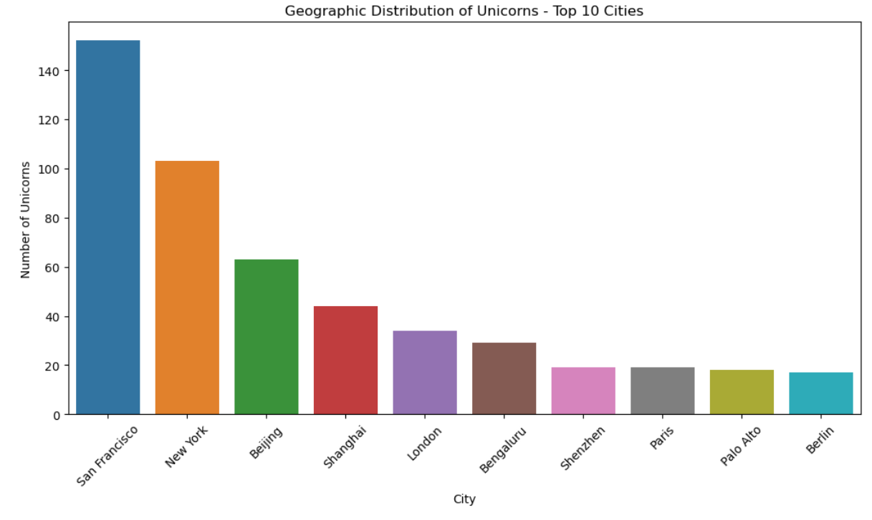
Geographical Diversification
The data shows that most of the Unicorn companies are based in countries like the United States and China, and cities like San Francisco and Beijing. Investors can diversify their portfolios by also investing in Unicorn companies in other promising locations.

Slide 4
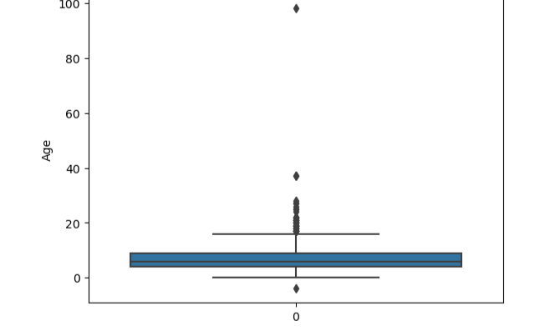
Age of Company Consideration
The ages of the companies, when they joined the Unicorn list, varies. Thus, investors should not rule out younger or older companies when considering investment opportunities. Each comes with its own risks and opportunities: younger companies might offer high growth and innovation, while older companies might provide stability and steady growth. However, it shows that it takes an average of 10 years to become a unicorn.

Slide 5
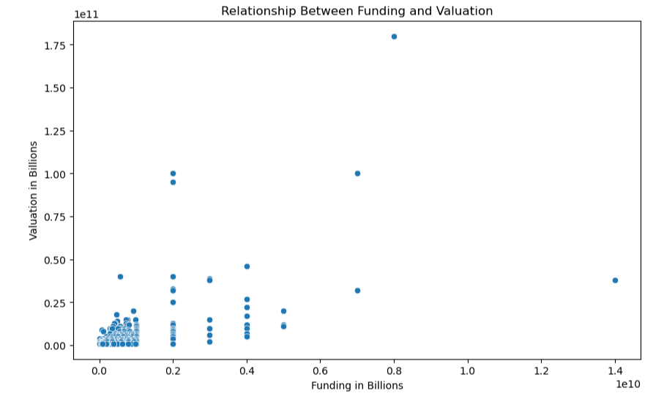
Funding and Valuation Correlation
No relationship between funding and valuation was observed. While higher funding doesn't guarantee a higher valuation, it can be one of the factors to consider. Companies that have attracted more funding might have done so because they have convincing business models or growth potential.

Slide 6
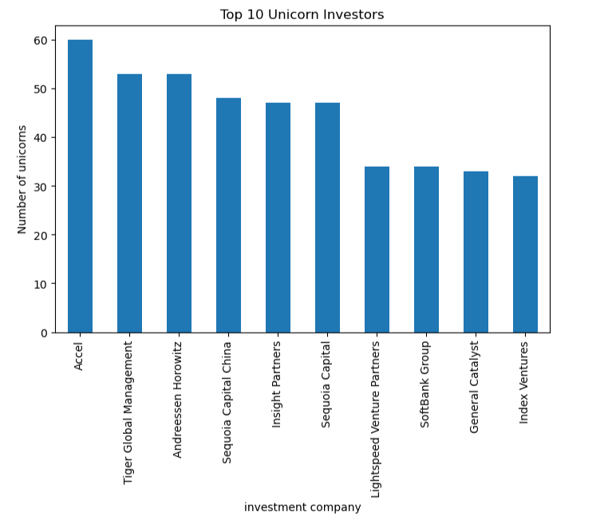
Top companies to seek funding from.
Here are the top 10 companies that have provided funding for the most unicorns.

